Slide 1
Pre-Calc & Trig
Day 2

Slide 2
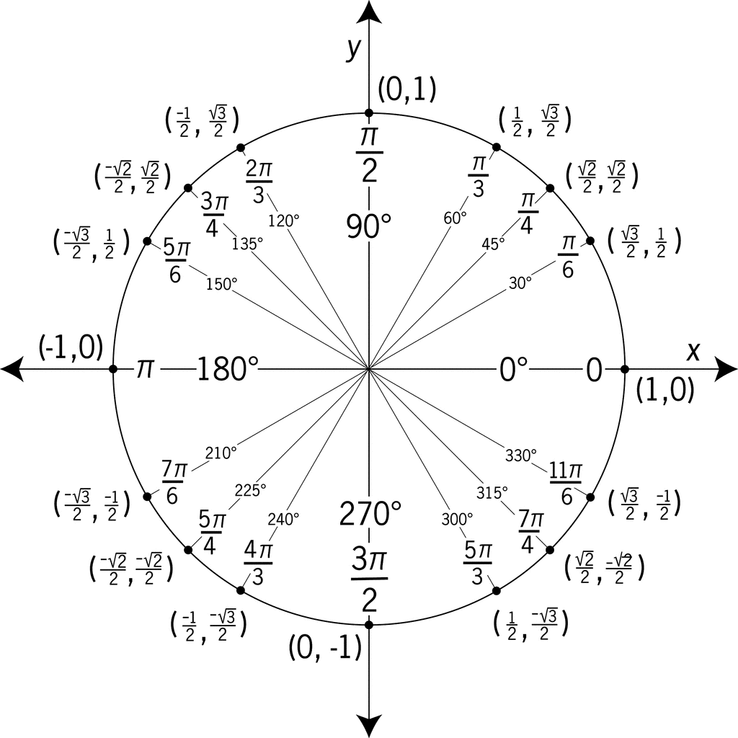
Bell Work (7-10 minutes work quietly, think about the questions below)
Individually: Create a list of as many of the things that you notice about the Unit Circle at right.
Class List: Compile a list on the board as a class with as many as you can come up with.
Share with a Partner: Compare and contrast your list.
Next Slide… larger image of Unit Circle

Slide 4
Bell Work: A few key points…
Did you point out similarities and differences between the coordinates?
How does this relate to a normal x-y coordinate grid? (Positive and negative connections?)
Is there a relationship between the degrees and radians? (What the heck is a radian?!?)
Did you identify a radius for the circle? How did you know?
What pattern exists to easily identify the fractions with pi around the circle?
What else did you find?

Slide 5
Objective
Use a project with Pentominoes to continue our understanding of patterns, by incorporating plotting points.

Slide 6
Graphing Project (2-4 minutes… pass out graph paper and markers)
Need:
Large Graph Paper
2 different color of markers (or simply a pencil and pen)
Pentominoes Slide (coming)

Slide 7
Project Directions (Phase 1)
Select 2 or 3 of the Pentominoes on the following slide.
Create a tiled pattern on your graph paper… using the 2 or 3 Pentominoes that you select (alternate colors where you feel it is appropriate to help understand the pattern you are creating).
You will be coloring in the squares on the graph paper to make the shapes
Only fill in ½ of your graph paper with your pattern and then stop.

Slide 8
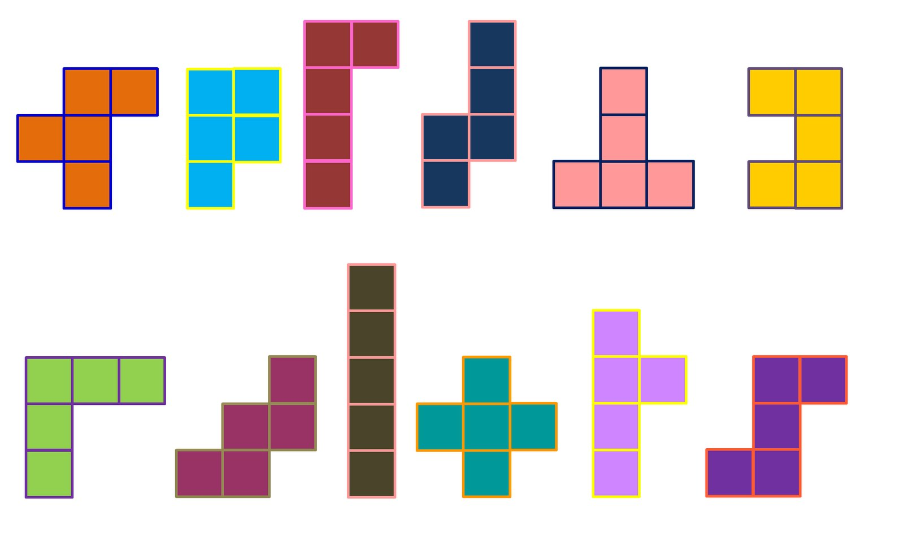
Pentominoes (you will be selecting 2-3 of these to make your pattern)

Slide 9
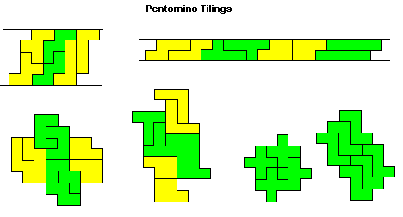
Examples of Pentomino Tiles (try to create your own, don’t just copy these…)

Slide 10
Okay… Go! Get Started with Phase 1 (15+ minutes)
Select 2 or 3 of the Pentominoes on the following slide.
Create a tiled pattern on your graph paper… using the 2 or 3 Pentominoes that you select (alternate colors where you feel it is appropriate to help understand the pattern you are creating).
You will be coloring in the squares on the graph paper to make the shapes
Only fill in ½ of your graph paper with your pattern and then stop.

Slide 11
Project Directions (Phase 2) (20ish+ minutes)
Get in groups of 2-3 people
Switch your papers so that you no longer have your own pattern
Take 3 minutes to quietly look at the pattern (do not write anything)
Take turns discussing in your groups (1-2 minutes each) on what you think the pattern is, and clarify with the originator if there are questions
Now continue to draw the pattern on your ‘new’ Pentominoes tile (in other words I will be finishing someone else’s pattern)

Slide 12
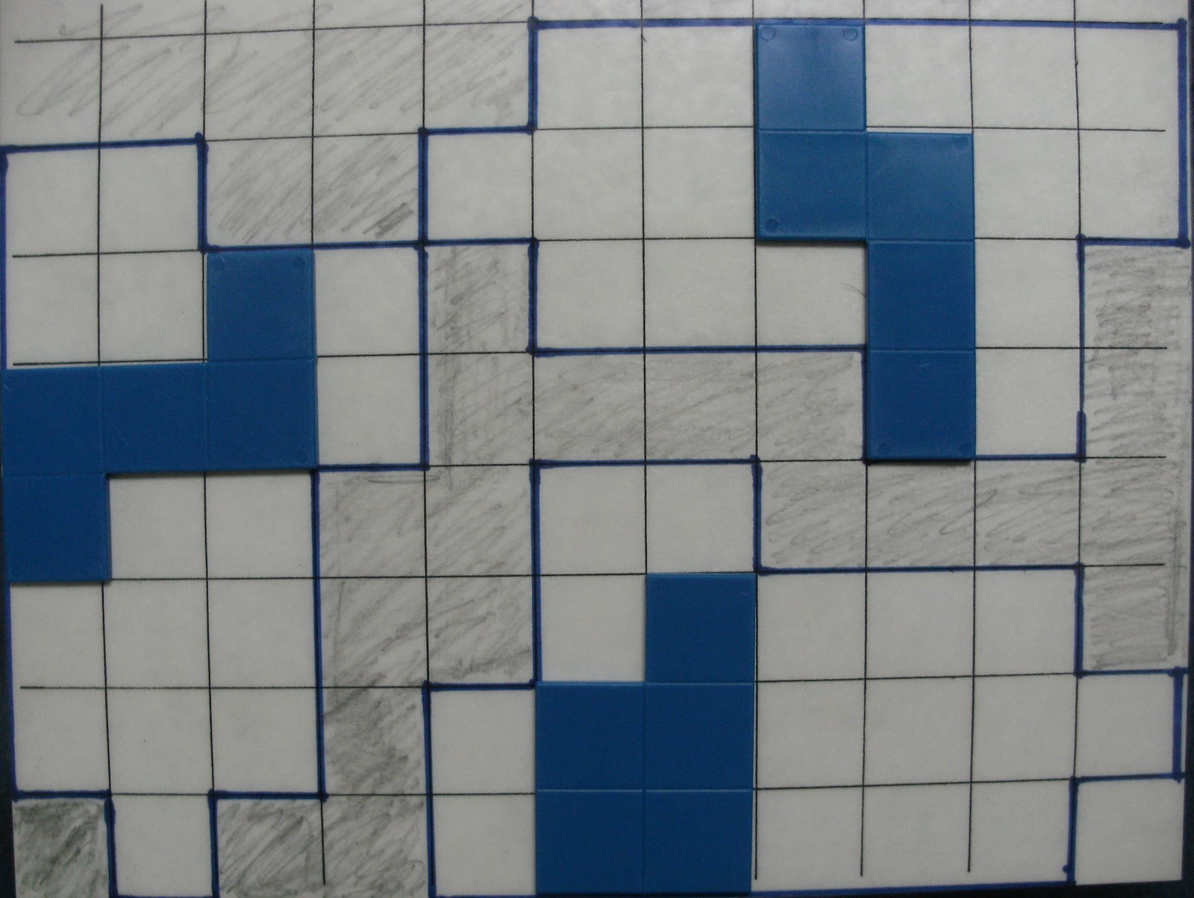
Project Directions (Phase 3) (10-15 minutes)
Identify 2 Pentominoes in each quadrant (what the heck is a quadrant?!) and outline, highlight, or identify in some way that those are the 2 you are talking about in each quadrant.
Example: The solid blue (at right) are clearly identified as the 3 you are talking about (do this in each quadrant).
■ On a separate piece of paper (or around the outside of the grid, write the all of the coordinates of the 8 individual Pentominoes.
■ Return the paper to the originator, and have them check that the coordinates in fact do correspond to the correct Pentominoes

Slide 13
Project Directions (Phase 4) (10-20 minutes)
Have one group member share one of the projects from the group. (It doesn’t have to be their own that they share).
Things to Discuss:
Most challenging piece
What went into making the pattern complete
If time permits, have the presenter read off the coordinates for 2 of their Pentominoes, and have the other groups graph their location

Slide 14
Exit Slip (5ish minutes… can be completed on back of graph paper)
What the heck is a Pentomino?
Why do you think they common in tiling floors and walls, or games like Tetris?
Where do you think it got its name, with a prefix like “Pento”?
Challenge:
Are there more Pentominoes than the ones
we worked with today? If yes, draw them. If no,
explain why there are no more.

